Slide 1
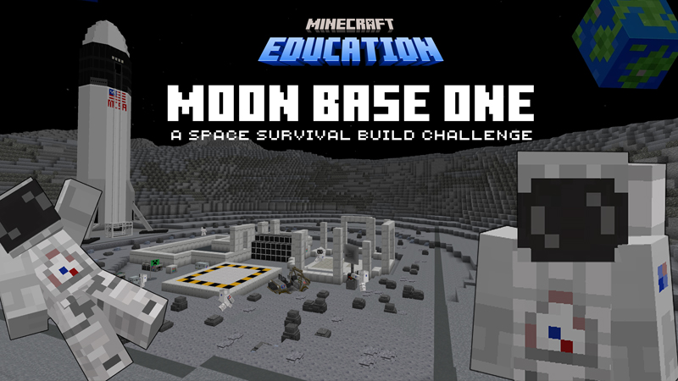
Inspired by the Artemis Missions

Slide 2
What will we learn today?
Connect to real-world NASA missions and future careers in space exploration
Collaborate effectively in a lunar colonization scenario
Manage resources in the limited lunar environment
Plan and construct sustainable energy solutions for long-term lunar habitation
Design efficient life support systems for thriving in space
Understand the basics of lunar geology and resource utilization

Slide 3
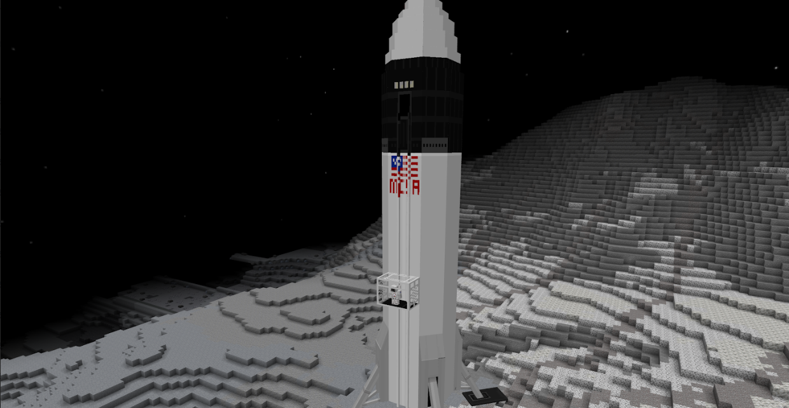

Return to the Moon
Welcome explorers! We need your help…
Today, you will be working as individuals or in teams to build a lunar base! You (and your teammates) are responsible for successfully creating a sustainable, livable base on the Moon.

Slide 4
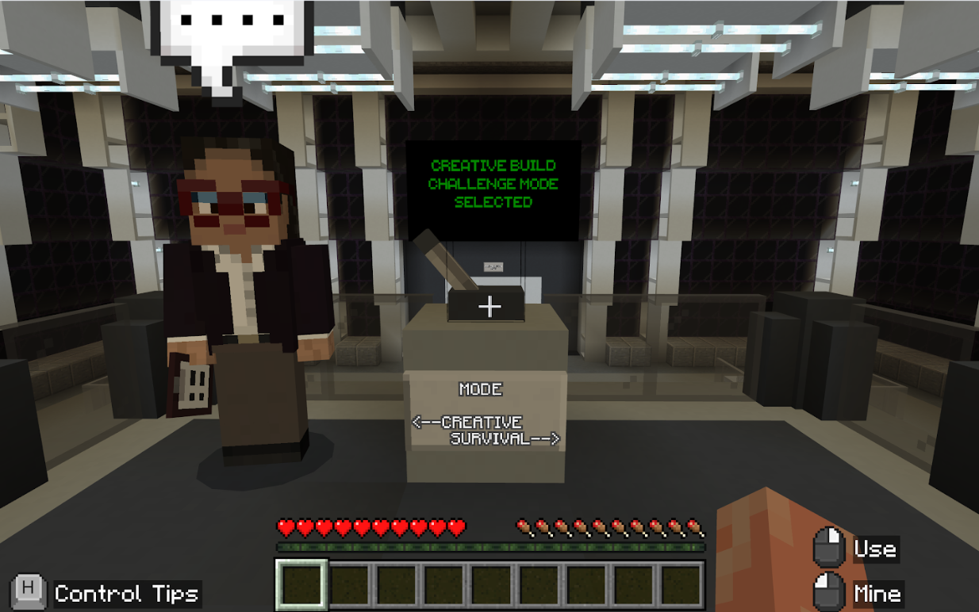
Start Game play
Welcome to Artemis: Return to the Moon!
You will start in Mission Control.

Slide 5
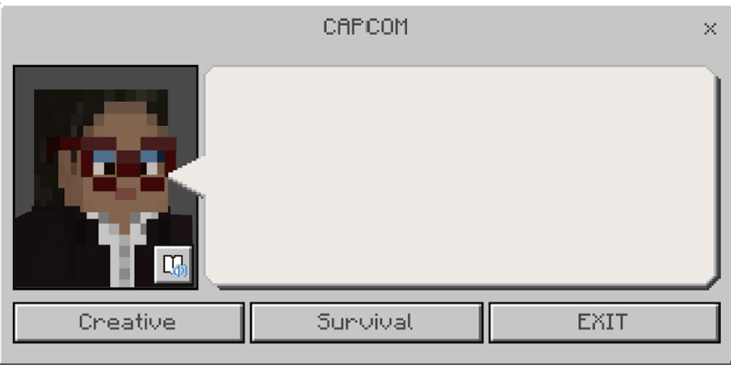
Immersive Reader
Immersive Reader can be opened inside Minecraft to read signs and NPC dialog! It is incredibly helpful! It’s great for extra help for reading, including translating the text and reading it aloud.
How to use Immersive Reader in Minecraft: Education Edition https://aka.ms/ImmersiveReaderYT

Slide 6
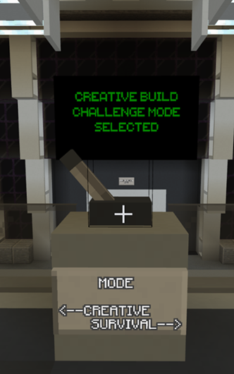
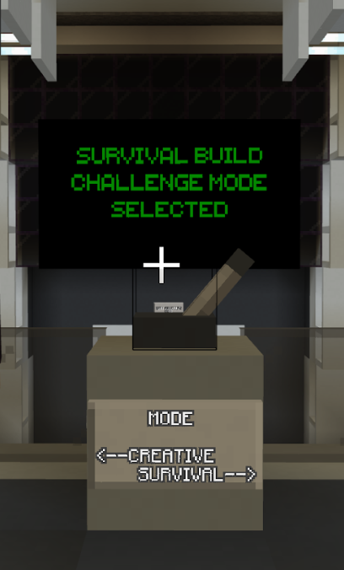
Select Game Mode
Creative | Survival
In creative mode, you will have access to all the available blocks in the game. You will not be affected by Moon physics. You will not need to worry about survival necessities such as food, water, or oxygen. | In survival mode, you need to consider survival aspects. You will experience Moon physics, must utilize tools and items, and manage your food, water, and oxygen supply. You will also have to collect and create new items to help you build and survive.

Slide 7
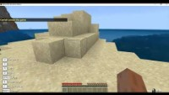
Hosting and joining a world

Slide 8
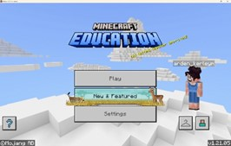
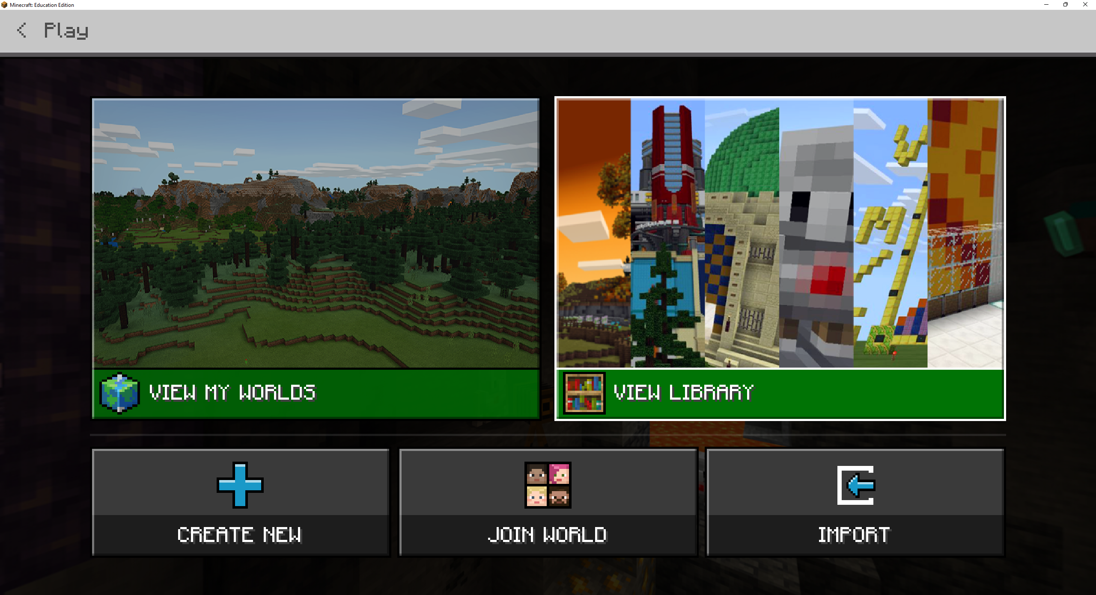


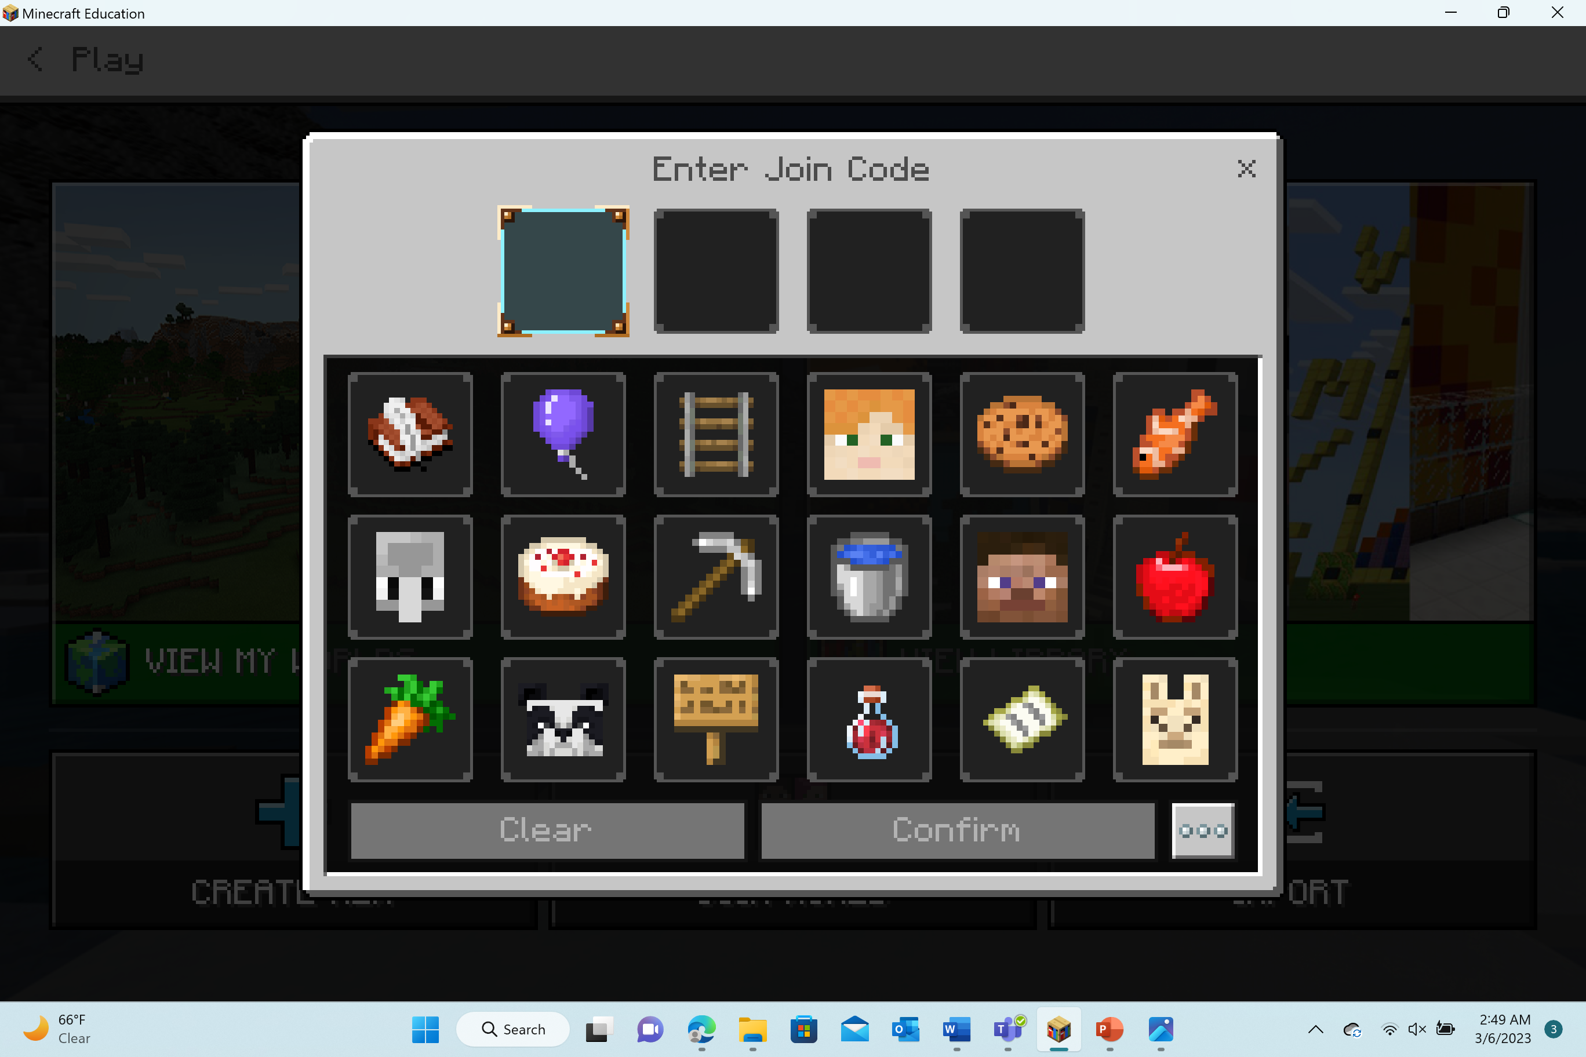
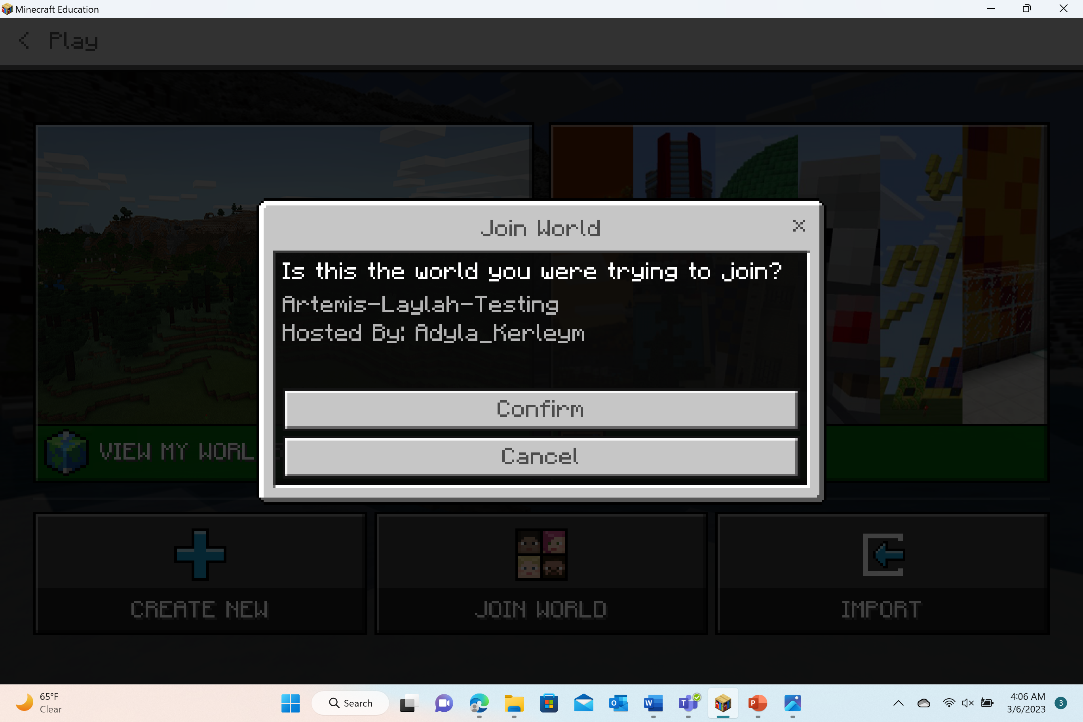

Join a world in Minecraft Education
1
2
3
4

Slide 9
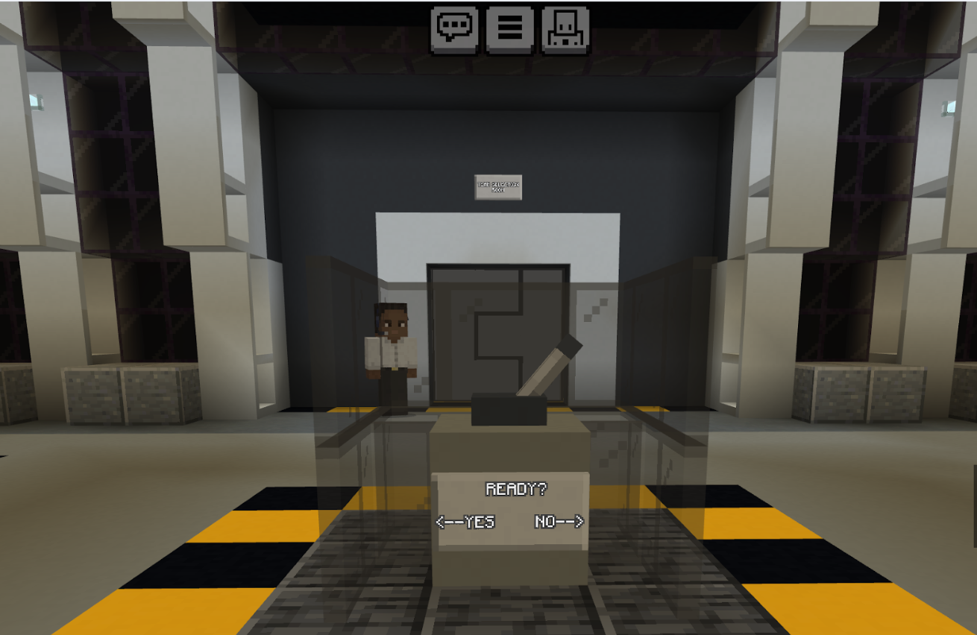
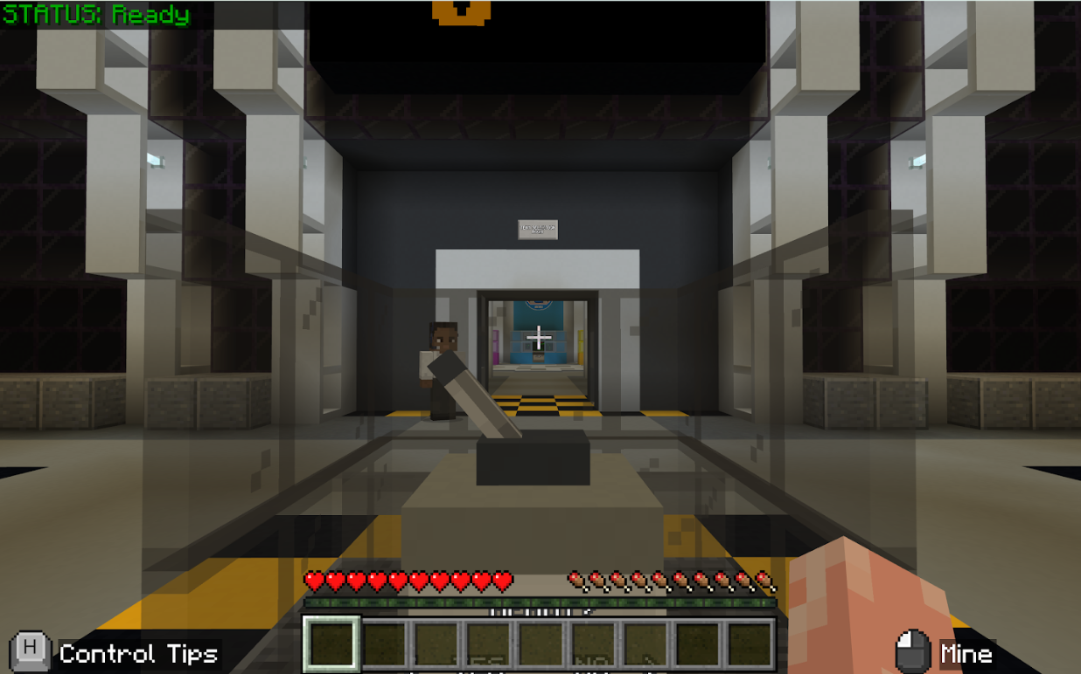
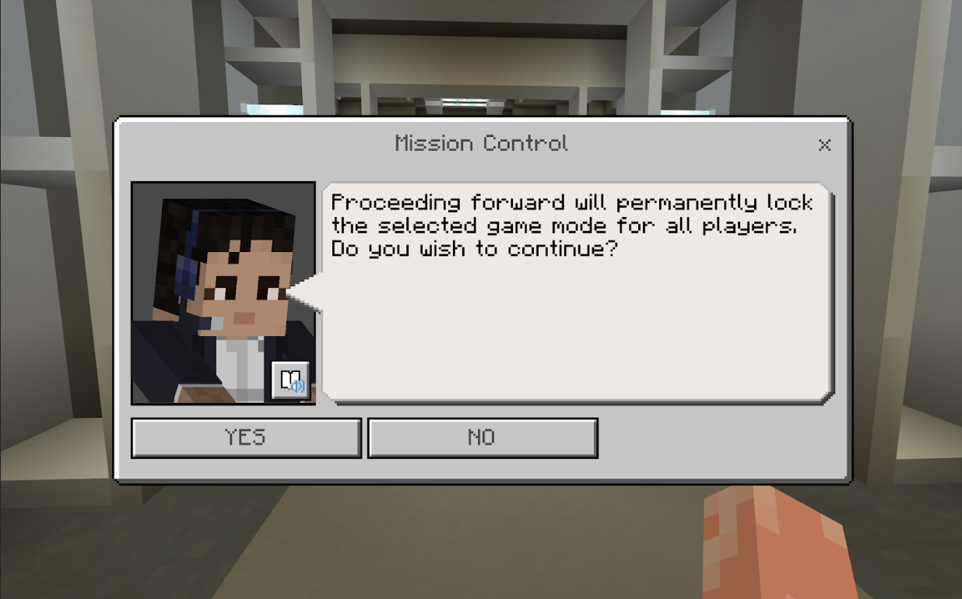
Confirm Game Mode
After you have decided on your game mode with your peers, you will need to switch the lever from “NO” to “YES”, the doorway will open for the players to continue to the Team Selection Room. You will receive a dialog box explaining that this will lock the game mode for you and your peers.

Slide 10
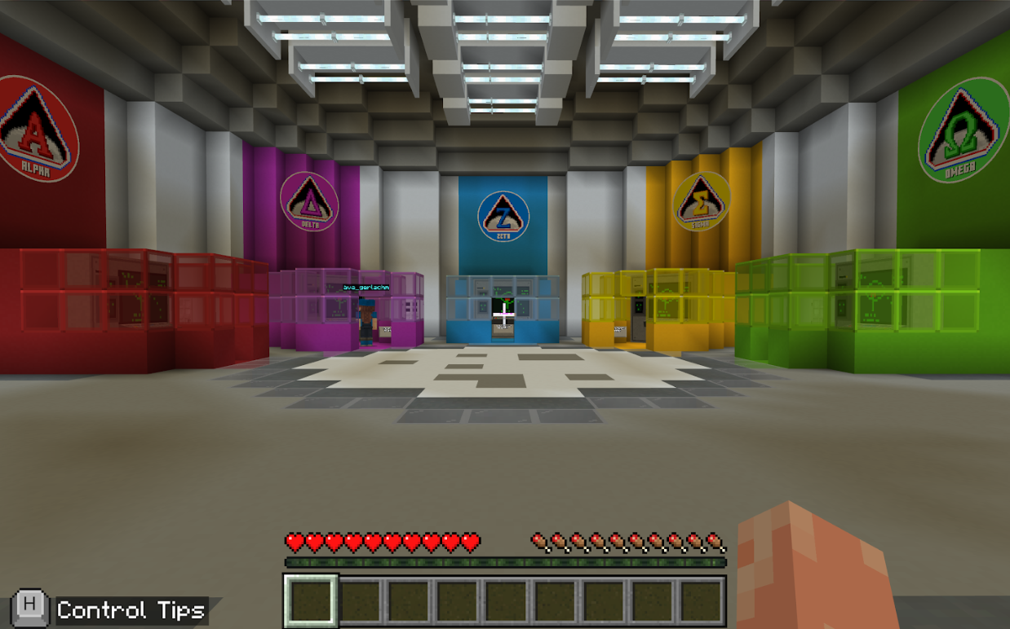
Team Selection Room
Welcome to the Team Selection Room! You (and your peers) are ready to select a lunar mission! There are 5 different missions.

Slide 11





Team Missions
Team Alpha
Team Alpha’s mission is to establish a base high in the Moon’s mountains. The terrain is treacherous, but this unforgiving biome offers a unique opportunity for exploration.
Team Delta
Team Delta’s mission is to create a settlement in the foothills of the lunar surface. The landscape is a medley of mesas and valleys that can provide excellent resources but may prove a challenge for construction!
Team Zeta
Team Zeta’s mission is to develop a community in a crater on the Moon. Thousands of celestial impacts have created these depressions. Team Zeta has chosen one large enough to offer shelter and defenses yet not deep enough to freeze the systems.
Team Sigma
Team Sigma’s mission is to construct a base inside of one of the Moon’s ancient lava tubes. The tubes offer protection from surface hazards, but also limit sunlight, making this a cold and dark expedition.
Team Omega
Team Omega’s mission is to build a base in the lunar lava fields. The flat lands here are surrounded by gorges where lava once flowed, making it an ideal location for a long-term outpost.

Slide 12
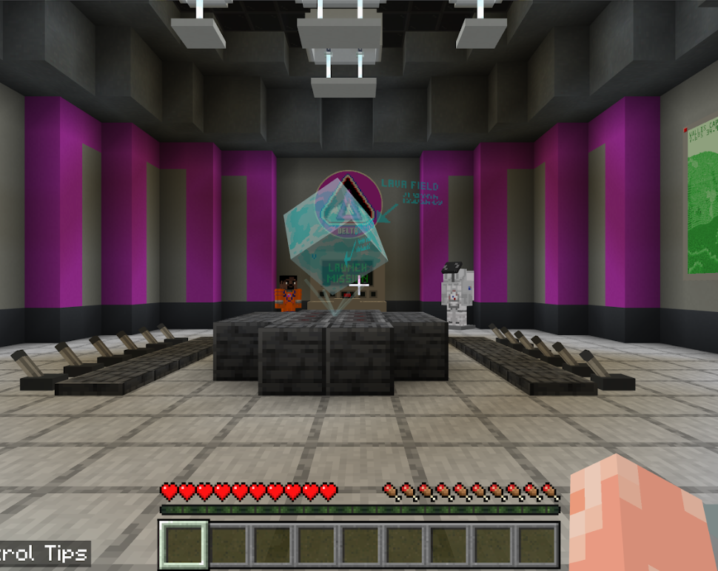
Mission Selection
Interact with the computer for the mission you would like to join.
You will then be teleported into your team’s room.
You and your peers will wait until everyone is ready to begin the mission.
Once everyone is ready, the red button will launch the mission for all players on that team.

Slide 13
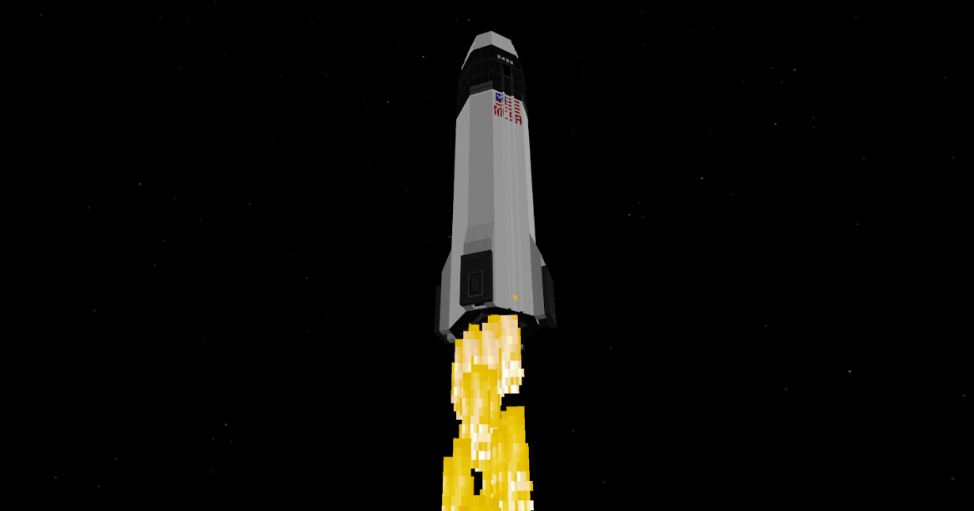
Time for Launch!

Slide 14
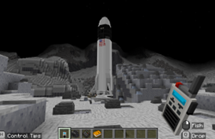
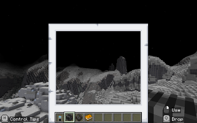
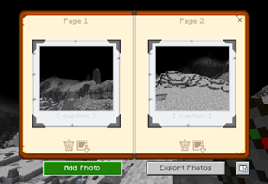
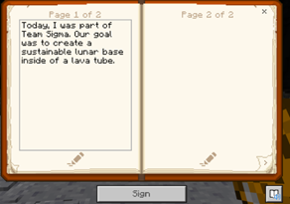
Important items
Upon arrival on the Moon, all players will find the following in their hotbar:
Optic ComLink
This is a radio that you can use to communicate with Mission Control while you are on the Moon.
Astro-Cam
This is a camera. You will be able to take pictures of anything you would like during your Moon mission.
Photo Storage Device
Your photos taken with the Astro-Cam will show up here. You can add captions to label your photographs.
Journal
This journal will be your way to capture thoughts, learnings, and even wonderings about your Moon mission.

Slide 15
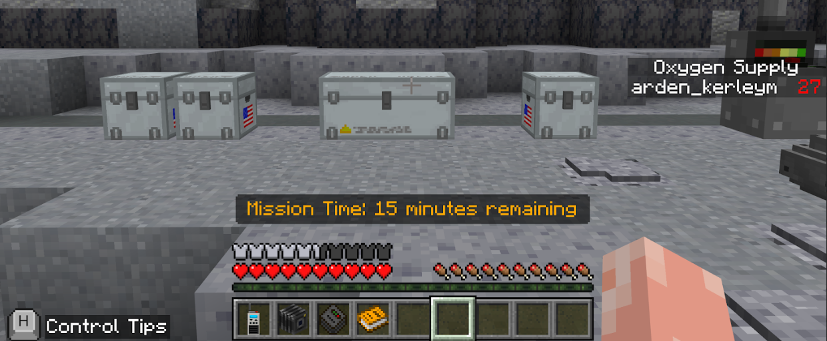
Helpful Information
If you are playing in Survival Mode, there are some extra considerations.
Oxygen Supply | Damage | Hunger | Tools | Materials
Players will have to pay attention to their oxygen levels. There is a screen display in the game. As needed, players can refill their oxygen by collecting an oxygen tank from a chest. | In case a player receives damage during game play, there is a medical kit. There are several first aid injectors and medicine refill vials. | Hungry? Thirsty? There are some astronaut favorites in the chest provided for you… You will find both food and water. | You can utilize the tools provided to make collect and make new materials for your lunar base. | In order to complete a lunar base, there are pre-fab building materials already made for you. Search inside the available chests.

Slide 16
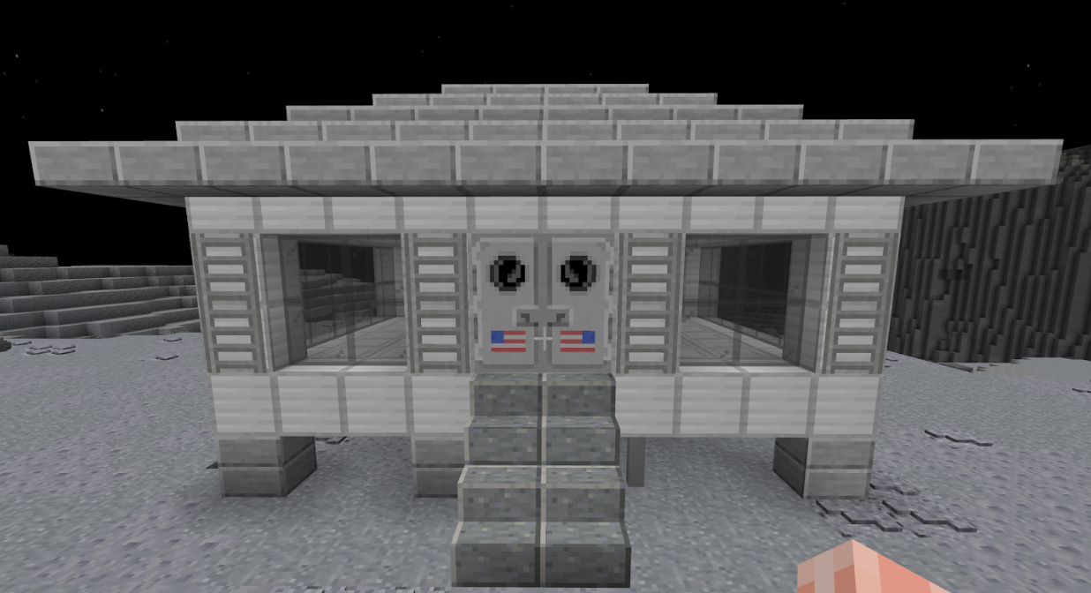
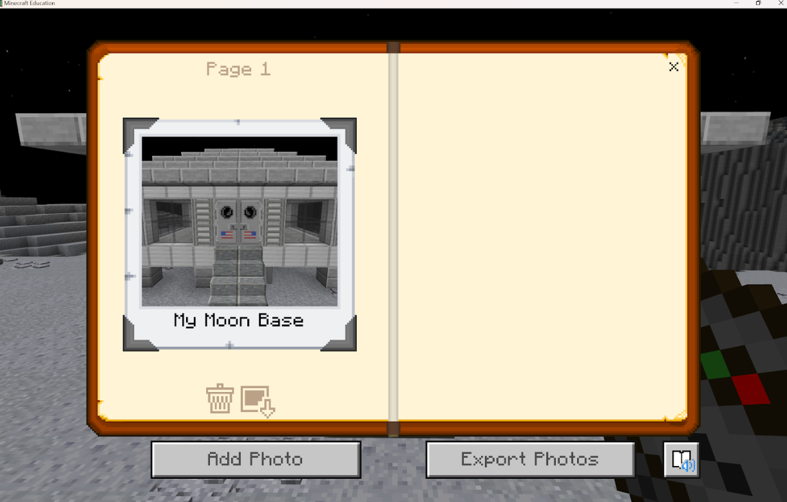
Your Mission
During the allotted time, your goal is to:
Collaborate and communicate with your teammates (if applicable)
Design and build a lunar base
Take a photo of your finished base with the Astro-Cam

Slide 17
Good luck and have fun!

Slide 18
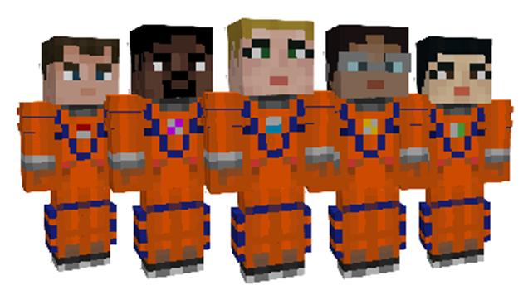
Reflection
What mission did you participate in today?
How did you use collaboration and communication with your teammates?
Why is lunar exploration important? How does it support the Artemis missions?
What kind of jobs and skills are related to lunar exploration?
Describe your experience – did you enjoy your lunar mission? What was easy for you? What was difficult for you?

Slide 19

Looking for more fun?!
Try another team missions! Remember – there are five missions in total.
If you played in creative mode, then try playing again in survival mode – or vice versa.
Consider checking out the other Artemis missions if you have not played them:
Artemis: Return to the Moon
Artemis: Rocket Build

